Slide 1
eBook: Consulting Skill Development
Background & Target outcomes
Training Curriculum Decisions
Project Proposal, Team & Fees
Detail on our Approach & Options
pages 3 – 5
pages 6 – 8
pages 9 – 14
pages 16 – 24

Slide 2
Accelerating skill development can enable today’s
Consultant to contribute £500k+ more profit over 6 years
@ 3-year promotions = £1.1m margin over 6 years
@ 2.5-year promotions = £1.6m margin over 6 years
Manager
2 – 3
years
Sen C
Sen C
Sen C
2 – 3
years
C
C
C
C
C
C
C
Typical
£80 - 90k margin
Typical
£270 - 300k margin
Typical
£650 - 700k margin
Reducing “time-to-promote” by just 6 months can increase total margin that person contributes by half a million pounds over a 6-year period
2

Slide 3

4 Steps to build a bullet-proof skill development engine
1
Focus on what differentiates you + what you need to deliver for clients. Also consider core consulting skills and operational needs.
Define, in detail, the capabilities you need to deliver your strategy
2
Create a competency matrix that is flexible, with career paths that allow people to choose what works for the firm + works for them
Define expectations for each role and create flexible career paths
3
Measure your current skill gaps and identify priorities
Define performance review tools & processes and gather baseline data. Identify gaps – firm-wide, peer groups, individuals.
4
Make a plan - training, coaching, experience, processes etc.
Decide how best to close gaps and create a training curriculum for each role.
Upgrade processes where needed.

Slide 4

10 attributes of the typical target end state
Capabilities needed to deliver our strategy are crystal clear
Progression through each capability, from Base to Master, is clearly defined
Expectations of each role are clear to everyone
Career paths are flexible, with individuals able to align their own interests with the firm’s
Performance review processes are consistent, trusted, and drive decision making
Skill gaps are regularly assessed at three levels – firm, peer group, and individual
We have a plan to address skills gaps systematically - recruitment, on-the-job experience, coaching, training
Project allocations processes / decision rights are clearly defined & consider development needs
Coaching is part of our DNA and drives on-the-job development
Training curricula and annual calendars are clear for each peer group
We consider these attributes in defining your target end state
Which are most important to you? Where are improvements needed?
4

Slide 5
Training curriculum design is a complex set of decisions
Who?
Roles & Seniority
What?
Skills & Behaviours
When?
Career
Calendar
Capacity
How?
Delivery
Types
Instructional Strategies
Content Formats
Trainers
See more detail on the Honeycomb approach to Training Curriculum Design: https://app.klaxoon.com/join/YPGNWYT

Slide 6

Target outputs: What we understand you need
Who?
Roles & Seniority
Business Analysts, Associate Consultants, Consultants, Senior Consultants, Partners
What?
Skills & Behaviours
Build on your Grade Framework & pressure test level of detail required
When?
Career
Calendar
Capacity
Core outputs for this phase of work
How?
Delivery
Types
Instructional Strategies
Content Formats
Trainers
Key output, within training curricula we design
Detailed work to be done as part of implementation & learning design in 2024

Slide 7
TASK: Run 3 half-day workshops to agree
Pre-work
1. Capabilities
2. Skill Development
3. Training Plan
Purpose
Ensure we consider all relevant inputs
Agree detailed capability expectations (aligned to strategy)
Review first draft training curricula by grade
Finalise training plan & agree how to implement
Approach
Review existing work
Issue survey to all team members
Run 3 x peer group interviews
Interview Partners
Build fact-base
Review pre-work inputs
Link capabilities back to your strategy
Agree expectations by grade & identify any remaining gaps
Discuss training plan principles
HC present draft training curricula by grade:
  Flagship programmes
  Standalone modules
  Self-serve content
Discuss delivery modality & trainer options
Review draft calendar
Agree final training curricula and initial annual calendar
Discuss 2024 priorities
Decide on action plan & assign owners
Agree next steps
Timing*
Month 1
Month 1
Month 2
Month 2
Fact-base to inform Workshop 1
Clarity on the precise skills you need
First cut training curricula by grade
Final training plan with clear owners & actions for 2024

Slide 8
There are 2 optional pieces of work that build on and maximise benefits of core training plan output
Core
output
Senior team aligned on training plan (curricula and calendar) for all grades, and clear on who will do what to implement.
Consider: Senior Alignment with decision processes
Consider: Learning impact analytics
Optimised skill development combines on-the-job learning, feedback, coaching and training
Your training plan needs to work alongside project allocations and performance review processes
We can review these processes, define decision rights (using Bain’s RAPID framework*), and recommend updates
New processes will ensure development priorities are consistently identified & fed through to future training and project allocations decisions
Measuring the impact of your investment in training and skill development is valuable, but not easy
Our Impact Analytics methods identify immediate impacts on mindset & behaviours and then follow the ripple effects through to commercial outcomes
Alongside training plan development, we can design learning impact measures and gather baseline data ahead of implementation in 2024
This will enable you to know which training is most effective and what impact it is having

Slide 9
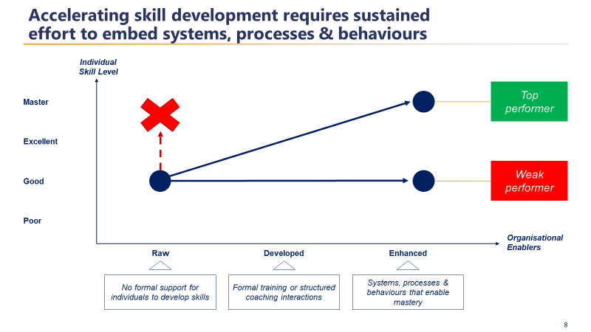
A systematic Approach

Slide 10
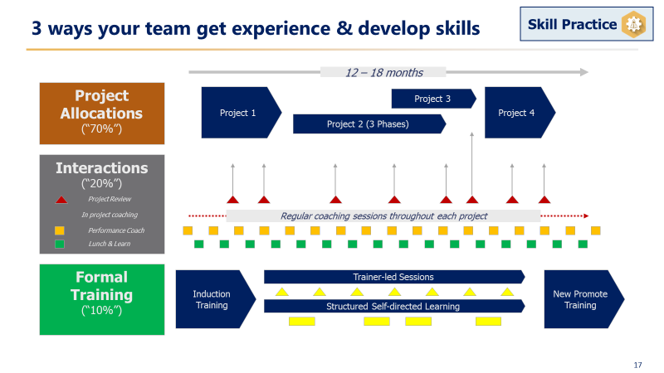
Optimise Skill Development

Slide 11
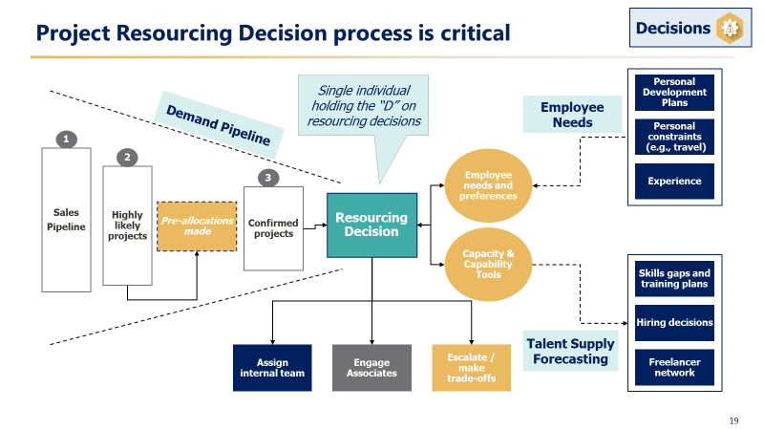
Skills needs should input into resourcing

Slide 12
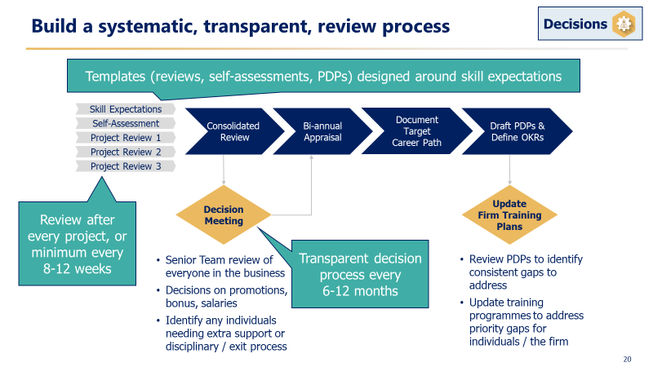
How to build Performance

Slide 13




Build Learning Impact Analytics
Individual
Accelerate Skills
Peers
Amplify Impact
Firm
Shifting behaviours
Clients
Trust & revenue
Reach & Engagement
(training completion rates)
Continuous monitoring
Top-down analyses
Regular cadence
IMPACT
Consistent measurement methods across all multiple touchpoints
Participant Sentiment – towards self and the experience
(experience of training & new behaviours, on self)
Ripple Effects
(emergence and impact of new behaviours on peers, firm, clients and output metrics)
SENSEMAKING
Helping learners see the impact & ripple effects of their changes
Cyclical deep dives
Bottom-up analyses
Reflective discussions
SENSEMAKING
Finding the ‘so what’ of the data they are seeing
Firm-wide insights
At this stage, we recommend defining the measures that will be useful to you and gathering baseline data ahead of your 2024 training delivery
*See slide 24 for more detail on baseline metrics, key measures and the insights these give you
13

Slide 14
10: Training curriculum design is a complex set of decisions
Who?
Roles & Seniority
What?
Skills & Behaviours
When?
Career
Calendar
Capacity
How?
Delivery
Types
Instructional Strategies
Content Formats
Trainers
See more detail on the Honeycomb approach to Training Curriculum Design: https://app.klaxoon.com/join/YPGNWYT

Slide 15
Detailed skill expectations drive clarity & consistency
What?
Illustrative Example
Business
Development
Firm
Advocacy
Project
Management
Delivering
Client Value
Purpose | Exceptional clarity and quality of written outputs is critical for our reputation and impact We must also engage clients verbally in a way that builds rapport, gives them confidence, and showcases the quality of our thinking
Base | Spots and corrects basic errors (spelling, grammar) before sharing work Makes attempt to sense-check own outputs With significant support, able to produce individual pieces of content
Good | Able to structure a document in line with our guidelines (but not consistently) With limited support, creates grammatically accurate and engaging individual pieces of content Requires significant support to get to first draft of complete documents
Excellent | Trusted to consistently structure documents in line with our guidelines Independently creates high quality individual pieces of content, from concept to finished Able to produce first draft complete outputs that can be finalised with limited support
Master | Sought out expert on writing & communications Independently and consistently delivers compelling, error-free, complete documents ready for publication
Long-term
Relationships
Complex
Data Problems
Master
Excellent
New Client
Conversion
Writing &
Communications
Good
Base
Leadership
Resourcing
Personal
Attitude
Recruitment
Client & Team
Interactions
Business
Operations
Client
Relationships
Reporting
15

Slide 16
Expectations can be tailored for individual career paths
What?
Business
Development
Firm
Advocacy
Project
Management
Delivering
Client Value
Long-term
Relationships
Complex
Data Problems
Master
Technical guru
Excellent
New Client
Conversion
Writing &
Communications
Good
Sales lead
Base
Leadership
Resourcing
Personal
Attitude
Recruitment
Client & Team
Interactions
Business
Operations
Client
Relationships
Reporting
16

Slide 17
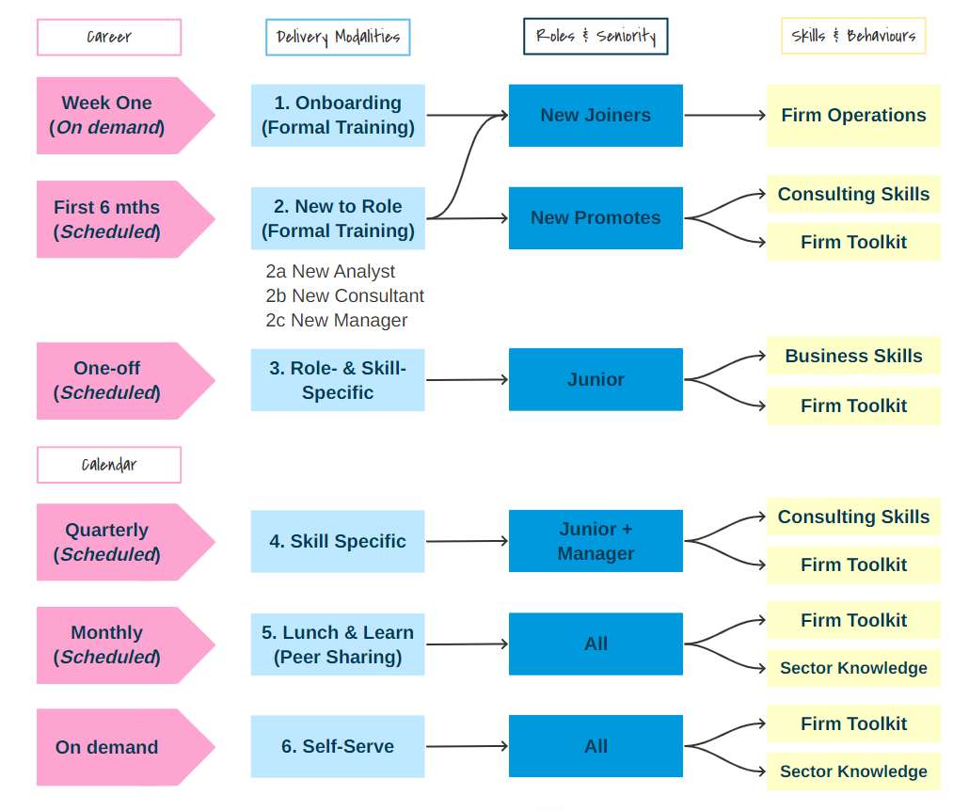
What Consider when in career, when in year, and team capacity
When?
Simplified Example
Career
When they need
When you can
Annual
Calendar
Scheduled
On-demand
Capacity
Learner availability
Trainer availability
Development time
17

Slide 18
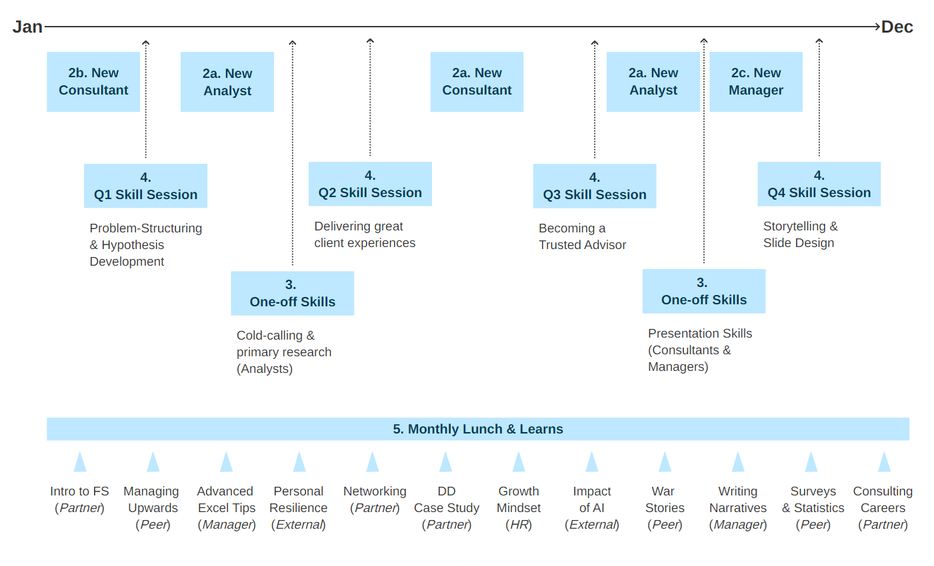
Create a whole-firm annual calendar
How?
Simplified Example
18

Slide 19
RAPID decision design framework
Option: Alignment with decision processes
There is only one R for each decision
Does 80% of the work to develop the recommendation
Broad visibility and access to data & relevant Inputs
Must have trust from both Is and the D
R and D can be the same person
RAPIDs should reflect what will work in 90% of situations – design for the rule, not the exception
Recommend
Decide
Perform
Input
Agree
Can be multiple Is for a decision
Assigned only to those with valuable, relevant information which could potentially change the decision
Avoid I proliferation!
As are used sparingly
Usually regulatory or legal issues
A is on the R – the D can still over-rule (and be held accountable)
There is only one D for each decision
This should be the person best placed to make that decision – balancing expertise & experience with the ‘value at stake’ for the organisation
If D belongs to a group, specify how it gets exercised (e.g., majority vote or unanimous vote)
May be multiple Ps
P may also be an Input - e.g., to ensure implementation is properly considered in the decision process
19
Note: RAPID is a methodology developed by Bain & Company
Notes:
How Can Product Managers Leverage the RAPID Framework?
As a Product Manager, your role involves a myriad of decisions, from feature prioritization to resource allocation. The RAPID Framework can transform this decision-making maze into a structured journey. Let’s break it down step by step:
Step 1: Recommend
The journey begins with recommendations. In this stage, individuals or teams propose actions based on their expertise or analysis. For example, your UX team might recommend enhancing the user interface for better accessibility.
Actionable Tip: Encourage a culture where team members feel empowered to make data-driven recommendations. Provide them with the tools and information needed to analyze and propose solutions effectively.
Step 2: Agree
The Agree step involves key stakeholders who must support the recommendation for it to move forward. These stakeholders could include senior management, cross-functional leaders, or even key customers. Continuing our example, the Product and Design leads would need to agree with the UX team’s recommendation, ensuring it aligns with the overall product strategy and user needs.
Actionable Tip: Facilitate regular cross-functional meetings to discuss and align on recommendations. Ensure that all stakeholders have a clear understanding of the implications and benefits of the proposed actions.
Step 3: Perform
In the Perform stage, individuals or teams are tasked with executing the decision. This is where the rubber meets the road. If the decision was to enhance the user interface, the UX and Development teams would now work on implementing the changes.
Actionable Tip: Define clear objectives, timelines, and KPIs for the implementation phase. Regular check-ins and agile methodologies can help keep the team on track and adaptable to changes.
Step 4: Input
Input is crucial for informed decision-making. This involves gathering insights, data, and feedback from a broad range of sources to inform the decision at hand. For instance, collecting user feedback through surveys or A/B testing could provide valuable insights into the proposed UI enhancements.
Actionable Tip: Develop a systematic approach for collecting and analyzing input. Leverage tools like user analytics, feedback platforms, and stakeholder interviews to gather comprehensive insights.
Step 5: Decide
Finally, the Decide step assigns the responsibility of making the final decision to a specific individual, usually a senior leader or the Product Manager. This person considers all the recommendations, agreements, performance plans, and inputs before making an informed decision.
Actionable Tip: Ensure that the decision-maker is equipped with all necessary information and insights. A structured decision-making template or dashboard that summarizes the key points can aid in this process.
Putting It All Together: A Real-World Example
Imagine you’re the Product Manager for a popular productivity app, and user feedback indicates that the app’s task management feature is not intuitive. Here’s how you could apply the RAPID Framework:
Recommend: The UX team conducts user research and recommends a redesign of the task management feature to improve intuitiveness.
Agree: You discuss this recommendation with the Engineering and Design leads in a cross-functional meeting, and they agree with the proposed redesign.
Perform: The UX designers and developers are assigned to perform the redesign, following a detailed plan and timeline.
Input: You gather input from beta testers and analyze usage data from the redesigned feature’s initial rollout.
Decide: Based on the positive feedback and improved user engagement metrics, you, as the Product Manager, decide to fully implement the redesigned task management feature across the app.

Slide 20
Example: Project Resourcing decision process
Option: Alignment with decision processes

Slide 21
Example: Project Resourcing decision rights & roles
Option: Alignment with decision processes

Slide 22
Option: Learning impact analytics
Impact Analytics builds depth & value of insight over time
Impact measure | Baselining Questions | Foundation Measures | Advanced Measures | Target Insights
Reach & Engagement Demographics, development reach & engagement - Objective data | Who is involved? How representative of the overall target population is this? What is the normal/ average level of commitment? | Employee demographics Learning/ training completion data Participant demographics | Relative engagement or commitment vs historic norms Indicators or patterns of commitment to development/ learning | Who’s been included in the training so far? What level of commitment exists in this population? Who is more / less engaged?
Participant Sentiment Experience Subjective development | How aware of opportunity to improve my skills am I before the training starts? | What do I think of the training that is supposed to help me? Which parts work best? Which parts don’t fit our need? | What level of awareness of my opportunity to improve do I now have compared to before? How do I feel about that? | How effectively is the product/ format working? How much might it influence my mindset / behaviour? What might explain my levels of engagement and/ or resistance?
Ripple effects - Behavioural shifts and impacts Skills and Mindset changes Amplify Impact (peers) | Operational data relevant to the skills being trained – e.g., productivity, revisions, Manager time etc. | How much is the training helping me? How much am I now prepared to start using the toolkits? | How much fear of change do I feel? Is that changing over time? What is ‘getting in the way’ of my release of fear – and what can I do about this? How am I encouraging others to do the same? | Is my attitude changing? Are self-perceptions translating into different behaviour? What am I actually doing? (i.e., using the tool kit or not) How is this starting to influence others around me?
Ripple effects - Operational and Commercial impacts Shifting Culture Team Trust Client Advocacy | Historic trends (pre-training) on core staff metrics Historic trends on selected client metrics Historic trends on use of the relevant tool-kit | Staff metrics (e.g., attrition, onboarding time to effectiveness, upward feedback etc.) Use of the tool kit Relevant activity Activity success measures | What is the speed to quantifiable commercial outcome changes? What is the size of commercial outcome changes? Can we begin to predict leading and lagging indicators in a more scientific and robust way? | Whether shifts in mindset/ behaviour are starting to influence or are linked in some way to positive operational and commercial outcomes? Which areas still require support and where can the learners learn from each other?
Depth and value of insight grows over time as ripple patterns emerge
22

