Slide 1


Masterclass
Digital Marketing 101

Slide 2
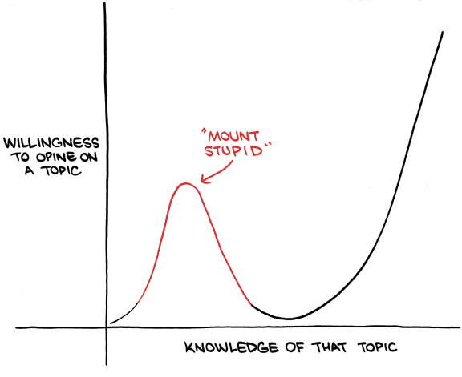

Slide 3

Digital Marketing 101
Finding Prospects
Creating Leads
Marketing System

Slide 4
Strategy
Services
Niche
Attract
Convert
Deliver
Goal
Entry Offer
UVP
Find Prospects
Call
Do
Mindset
Flagship Offer
Research
Build Trust
Sell
Learn
Plan
Recurring Offer
Marketing Themes
Educate
Follow-up
Upsell

Slide 5
Niche
Attract
Convert
Educate
Buyer Profile & Marketing Themes
Find Prospects
Ideal Client
Prospects
Qualified Leads
Build Trust

Slide 6


Find Prospects
Ideal client profile + challenges
Best 10 clients & buyers
Clients at purchase ‘trigger’
Google Alerts, LinkedIn Search
Targeted
Automated newsletter
Automated LinkedIn outreach
Email lists
Website & SEO
Blogs & SEO
Spray & Pray

Slide 7
Find Prospects
CHEAP
Automated Email Outreach
Existing clients
Case studies
Webinars
Hanging Out
Referrals
Automated LinkedIn Outreach
Blog / Guest blog
Conference speaker
Professional Association Speaker
Award Winner
Sponsorship
(Benchmarking) Reports
Pay per click ads
Podcast / Podcast Guest
Cold calling
Book Publishing
EXPENSIVE
LOW SUCCESS RATE
HIGH SUCCESS RATE

Slide 8
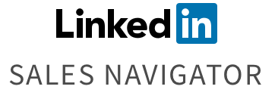
Find Prospects
“Find me all Deloitte alumni who are Directors and have an interest in leadership development”
“Find me all Oxford-educated CEOs whose companies have shrunk over the last year and who live in London”
“Find me CMOs in French medium-sized manufacturing firms that have been in their role for less than six months and who have a team of between 10-100 people”

Slide 9


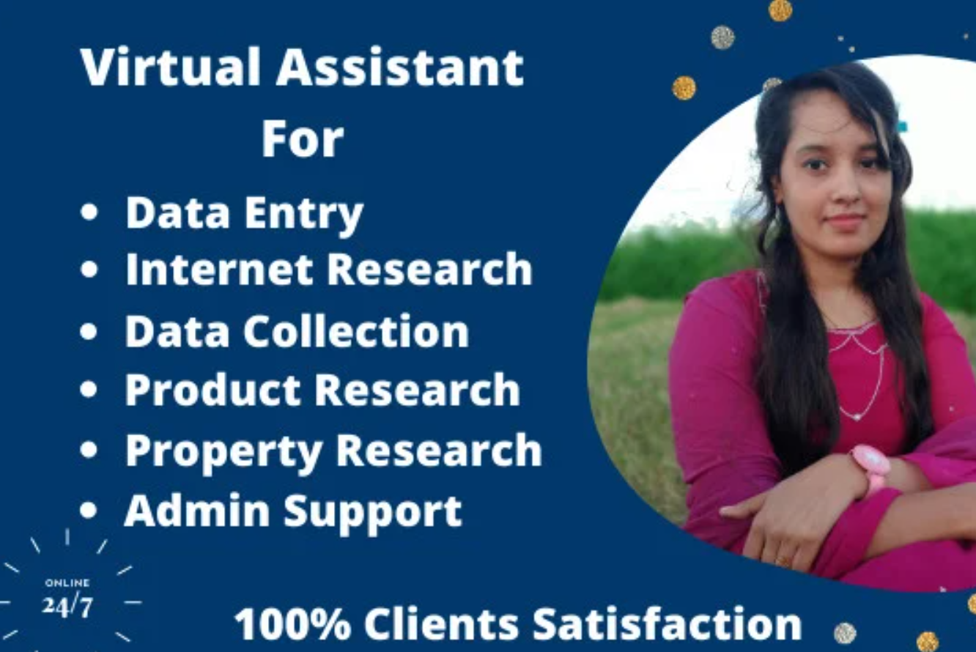

Find Prospects
FAME Database
Complete UK database
Size, sector, growth,
News reports
£5k-£1m
Email Lists
100 emails
Role, Size, Sector
£20
LinkedIn Automation
100 connections a week
Role, Size, Sector
Personalised introduction
£29/month

Slide 10
Educate
Find Prospects
Prospects
Leads
Build Trust

Slide 11
Educate
Content which is….
Build Trust
Consistent, and….
….useful, or
….educational, or
….evidence-based

Slide 12
Educate
Major Client Challenges
Your Unique Value Proposition
Build Trust
3-5 Key Themes (Pain & Gain)
Daily
Tweet
LinkedIn Status
Email
Weekly
Blog piece
Video
Monthly
Chapter
Webinar
Podcast
Yearly
Book / eBook
Report
Online Course

Slide 13
Educate
Build Trust
Daily
Tweet
LinkedIn Status
Email
Weekly
Blog piece
Video
Monthly
Chapter
Webinar
Podcast
Yearly
Book / eBook
Report
Online Course
Reuse
Accumulate

Slide 14
Educate
Find Prospects
Prospects
Leads
Build Trust
Existing Clients
Referrals
Speaking Engagements
Hanging Out
LinkedIn Sales Navigator
MeetAlfred
Fame Database
Consistent
Useful
Educational
Evidence-based
Re-used
Accumulative

Slide 15
Systems
Educate
Find Prospects
Prospects
Leads
Build Trust
Client Relationship Management (CRM)
Contact records & storage
Automated emails & newsletters
Tracks interactions

Slide 16
Systems
Social Media
Website

Slide 17
Systems
Emails / Newsletters
Social Media
Great Content
Client Relationship Management (CRM)
Website
Email Capture

Slide 18
To do…..
Content Strategy
  What are your client challenges?
  What is your UVP?
  What are your 3-5 content themes?
Content Execution
  What is your content plan (reuse & accumulate)?
  What is your high-value ‘lead magnet’ content?
  What is your subscription offer?
Content System
  Get a cheap CRM & input your emails
  Capture emails on your website
  Plan a 12 month subscription sequence

