Slide 1
Supporting Senior Progression
Notes:
Done

Slide 2
The transition to Partner
Business Case
In demonstrating a strong business case, the XXX will need to be tracking £XXXm revenue which equates to XXX heads billing. This will require a step-change as opposed to more of the same.
Your role as a Partner
What will your leadership role look like and how will this be different to your role as a XXX?
What changes are needed in the sector or service line (in terms of both capacity and capability) to allow you to do this?
What will you bring to the team in terms of skills, knowledge and experience?
What is your vision for the team, and the story that unites them?
What are your challenging thoughts and perspectives that will bring a diversity of thinking and perspective to the team?
What do you want to get from being a Partner?
What kind of leader do you want to be?
Building a sustainable team
Who will do what you currently do when you are a Partner? What do we need to be putting in place now to support them to be able to do this? This is really important in ensuring that your role changes when you progress and as such have the capacity to do a broader leadership role.
Looking ahead, where are the gaps across the Manager, Principal and Client Director grades? Which of these can be filled through the current talent pipeline and where do we need to recruit externally?
If and where we are looking at senior hires, what do we need, why do we need them (business case), when do we need them and what will they focus on?
How do we build in surge capacity so that we can respond to new opportunities that require scale quickly?
What support do you need from us in terms of building this sustainable team?

Slide 3
The transition to Partner
There are at least two core elements to the transition:
Transition process – the personal change journey
The content of the role - what it means to be a Partner
Each of these may have a variety of sub-components. I haven’t fully thought out the interrelationship / overlaps between these two.
There also other components which are probably more hygiene factors:
Business case
Sales / BD track record
Business leadership responsibilities
Personal journey as an Extraordinary Leader
….
These will be a case-by-case discussion, and driven by business context.

Slide 4
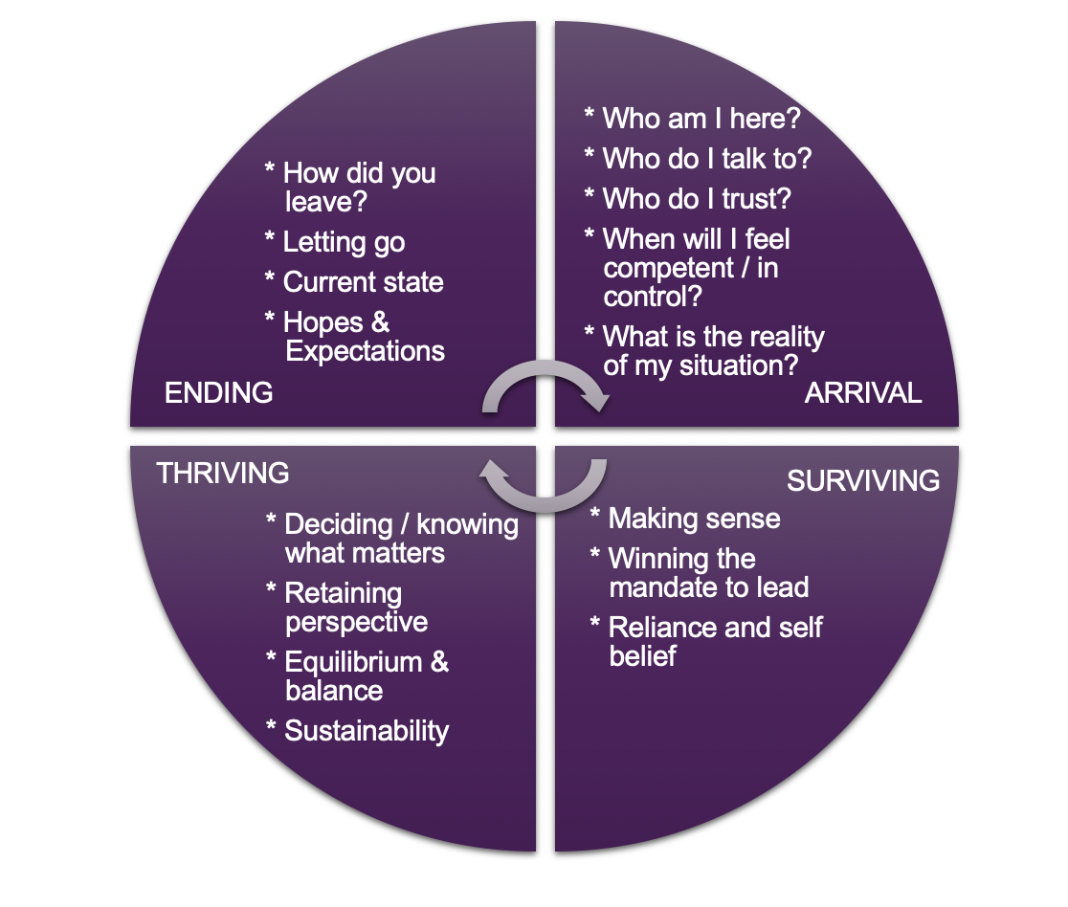
Transition process - personal change journey
Consists of an ‘ending’, a ‘neutral zone’, and a ‘beginning’ – each of these areas could require exploration as part of the coaching process, and these aren’t necessarily sequential as they may overlap / be cyclical
Ending:
Letting go of CD / Big Firm ways of working: what are these ways of working? what does letting go mean?
Support structures: we don’t work in isolation – rather, we are part of a system. What support do we need from our team to ‘end’? And from our peers?
How do we work differently with peers?
What’s stopping us from letting go?
Neutral zone:
Can be confusing and uncertain
Important to normalise this – it’s not unusual to feel this way
What is this phase teaching you?
Explore / identify personal values, to act as a north star during period of uncertainty
Build psychological flexibility (I can explain more about this)
New beginning:
What’s different about this?
How does it feel?
What surprises you?
How have relationships changed?
What’s your 90-day plan? Be deliberate about what you’re going to do. It’s not a drift into a super-CD role

Slide 5
Content of the role - what it means to be a Partner
Content focused rather than the personal journey
Explore behaviours
Being a custodian of part of the business, on behalf of the business
What will be your legacy? Think about that now….
Shadowing / mentoring opportunities?
Working in the Partner Team – what’s your place?

Slide 6
The transition to Partner
A few builds that need to be taken into account in supporting people on this journey…
For many, getting to “Partner” is a big ambition, you focus on it for a long time, you harness all that you have done and achieved and target it on this next level of manifest attainment. That is a big psychological and emotional investment. You achieve a lot, people say well done, you are delighted at your own abilities! ….and then you need to change – massively. You need to let go of many of those reference points and validated experience and start a learning journey again and appreciate that you are at the start of another journey. I think this can be challenging…plays to the importance of the neutral zone as a bit as a sort of firewall space.
Related to this and relevant to the new beginning is the realisation that many of those skills that got you to here are no longer important in the next steps. This takes a long time to understand for many. In the meantime, there are lots of expectations on you as “Partner” and what you are supposed to be (in your eyes and the eyes of others) all seeing and all powerful. But in reality, humility is a key aspect of leadership (not often needed on the journey to leadership) and this is the time to practice that. It is OK to fail, fall short and have weaknesses.

Slide 7
What a transition coaching programme could look like
What it means to be a Partner
Agree goals and focus for sessions
Your ‘sweet-spot’ – the thing that you are really good at, enjoy doing and will have a significant impact on the business
Session One
Session Four
Hopes and Fears
Personal Change Journey
High Performing Team (Lencioni’s Five Dysfunctions of a Team)
Session Two
Session Five
Personal Change Journey
TBC
Session Three
Session Six

