Slide 1
Example IP Valuation
Joe O’Mahoney

Slide 2
Agenda
IP Valuation Framework
  Interpretations
  Data used
Value of XXX IP
  State of Service Lines
  Trends in findings
How to increase value of IP in FY 24/25

Slide 3
IP Valuation Framework
Using IP Valuation Framework provided by Joe O’Mahoney
Judges IP by 12 categories & questions, 1-5 scoring mechanism:
Does it (the IP) enable faster delivery? | Does it improve project margin?
Does it get used consistently? | Does it enable better quality?
Does it support juniors? | Is it unique to XXX?
Is it difficult to reproduce? | How regularly is this updated?
Does the IP have any Legal Protections? | Are suitable version controls and permissions setup on IP?
Is IP packaged up as a service? | Would clients/competitors pay for access?

Slide 4
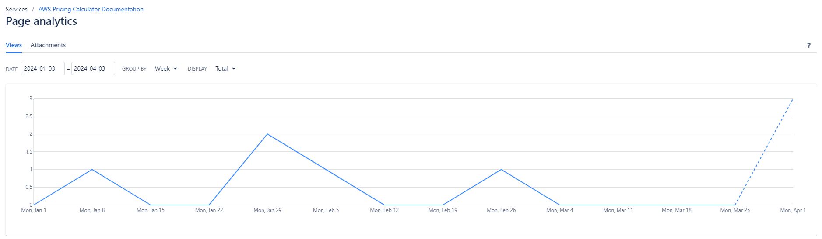

Is our IP used by our People? Is it updated regularly?
Data driven from the figures provided by Confluence, as well as qualitative assessment:
Page read stats for the year
Page read trends for the year
Page update logs

Slide 5
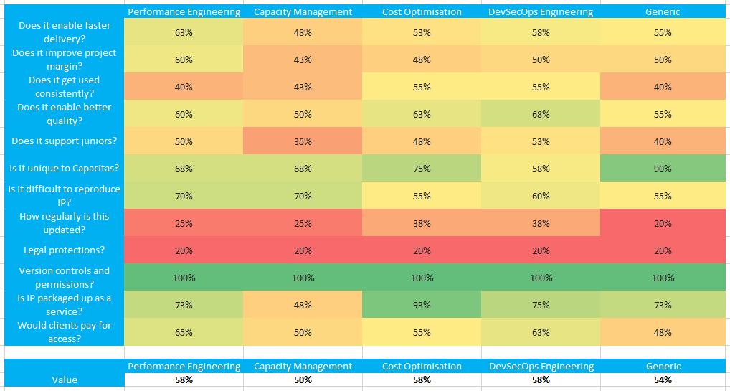
Value of XXX IP
Performance Engineering 58% value
Capacity Management 50% value
Cost Optimisation 58% value
DevSecOps Engineering 58% value
Generic Engagement Model 54% value

Slide 6
Value of XXX IP
Performance Engineering
PE IP is well-packaged to make it easy to sell engagements that are on-brand
A lot of the PE IP produced by XXX is also done to a level that is difficult to replicate by our competitors
However, content is out-of-date and isn't used enough by delivery consultants on PE engagements
Capacity Management
Cap Mgmt IP is very XXX-specific, and is therefore difficult for competitors to replicate, the way we do it
However, the content is out-of-date, has debatable impact on profit margins, and tends to support senior staff more than junior staff

Slide 7
Value of XXX IP
Cost Optimisation
Cost Opt IP is well-packaged and unique enough in the marketplace to make it easy to sell engagements that are on-brand
However, it's not updated regularly and is more used by senior staff than enabling junior staff to do quicker & better-quality work
DevSecOps Engineering
DevSecOps IP is well-packaged to make it easy to sell engagements that are on-brand
IP is also to a standard where there's confidence that using it will improve the overall quality of delivery work
However, it's not regularly updated and some bits of IP have debatable profit margin potential

Slide 8



Service Design Strategy for IP
IP is critical for driving up profit margin % of projects
There are 3 main areas to focus on and address in relation to IP, to drive up profit margin %:
Allow IP to support juniors
Make IP drive better efficiency
Increase billable utilisation

Slide 9
Allow IP to support juniors
Data shows where there is an imbalance towards senior grades due to missing IP to support juniors
Strategy steps
Get IP in a position where more junior resource can pick it up, as they roll onto projects
Reduce the need for senior resource; charge same amount, spend less on junior rates
compared to senior rates
Improve project profit margin by 3% (where imbalance exists, based on moving down one role at
each tier)
 | Performance Engineering | Capacity Management | Cost Optimisation | DevSecOps Engineering
Does it support juniors? | 50% | 35% | 48% | 53%
Current Workforce Split by Role | TOTAL: 8 | TOTAL: 6 | TOTAL: 10 | TOTAL: 26
 | PRINCIPAL+: 3 | PRINCIPAL+: 3 | PRINCIPAL+: 6 | PRINCIPAL+: 7
 | SENIOR: 0 | SENIOR: 1 | SENIOR: 0 | SENIOR: 5
 | MID-TIER: 2 | MID-TIER: 1 | MID-TIER: 2 | MID-TIER: 6
 | JUNIOR: 2 | JUNIOR: 1 | JUNIOR: 1 | JUNIOR: 6
 | INTERN: 1 | INTERN: 0 | INTERN: 1 | INTERN: 2

Slide 10
Make IP drive better efficiency – focus on project margin
Data shows there are areas to focus on to further drive up the ‘improved project margin’ rating, as with the standardised diagnostics and the cost extractor tool last year, for example.
Strategy steps
Ensure IP is in place to speed up delivery of work, and to drive high-quality of work too
Delivery resource spend less time performing duties, but deliver to just as high a standard
Charge same amount, spend less on time needed to deliver
Improve project margin by approx. 3% (based on hours saved with interventions last year)
 | Performance Engineering | Capacity Management | Cost Optimisation | DevSecOps Engineering
Training | 58% | 57% | 62% | 53%
Automation | 62% | 48% | 58% | 55%
Tooling | 55% | 52% | 67% | 57%

Slide 11
Increase billable utilisation
Data backs up the theory that average billable utilisation across the service lines correlates with how well the IP is packaged up as a service
Strategy steps
Ensure Service Line IP encapsulates as much of engagement flows as possible, driving
billable utilisation higher
Bring together the IP into a quick-to-deliver package
Improve profit margin, EBITDA by approx £300k (10% utilisation = 5 resources)
 | Performance Engineering | Capacity Management | Cost Optimisation | DevSecOps Engineering
Is IP packaged up as a service? | 73% | 48% | 93% | 75%
Billable Utilisation (Q4) | 73% | 67% | 83% | 75%

