Slide 1
Marketing Plan

Slide 2
Executive Summary

Slide 3
Executive Summary
Vision and Mission
Scope
Goals
Strategies
Budget

Slide 4
Situation Analysis

Slide 5
Situation Analysis
Market Analysis
Total Addressable Market
Market Penetration
Market Shares
Four Market Components

Slide 6
Situation Analysis
Competitive Analysis Matrix
Insights
SWOT Analysis
Insights
Customer Analysis
Customer Description
Approximate Number of Customers − Customer Persona
Buying Process
Customer Beliefs
  Importance Ratings
  Perception Ratings

Slide 7
Situation Analysis
Product/Service Analysis
Feature-Benefit Comparison

Slide 8
Strategy

Slide 9
Strategy
Segmentation
Demographic
Geographic
Behavioral (Benefit Sought)
Psychographic (Benefit Sought)

Slide 10
Strategy
Targeting
Opportunity by Segment

Slide 11
Strategy
Positioning
− Five-Box Chart
− Reasons to Believe (RTBs)

Slide 12
Tactics

Slide 13
Tactics
Products and Services
Features
Performance
Design
Customer Experience
Other Assets (warranties, etc.)

Slide 14
Tactics
Pricing
Value Analysis or Competitive Benchmark − Recommended Prices
Price Communication
  Who
  What
  Why
  When
  Where

Slide 15
Tactics
Promotion
Objectives
  Basic Awareness
  Top-of-Mind Awareness
  Information Awareness
  Behavioral Awareness
Media
  Channel
  Frequency

Slide 16
Tactics
Distribution Channel
Length, Breadth, and Depth
Channel Roles

Slide 17
Implementation

Slide 18
Implementation
Marketing Programs
Timing and Responsibility
Measurement
Key Performance Indicators

Slide 19
Financials

Slide 20
Financials
Budget
Revenue Forecast
  Specific, Measurable, Actionable, Realistic, and Time-bound

Slide 21
Appendix

Slide 22
Appendix
Team Members
Planning Process and Schedule
Key Assumptions

Slide 23
About & Mission
Who are we, and what do we stand for?

Slide 24
About
Looking for Marketing is focused on being a free directory resource for the marketing community. It’s built to help beginners and veterans learn and grow through industry books, events, and other resources.

Slide 25
Our Mission
To be the resource for people interested in the marketing field and for anyone looking to grow an online brand, product, or service.

Slide 26
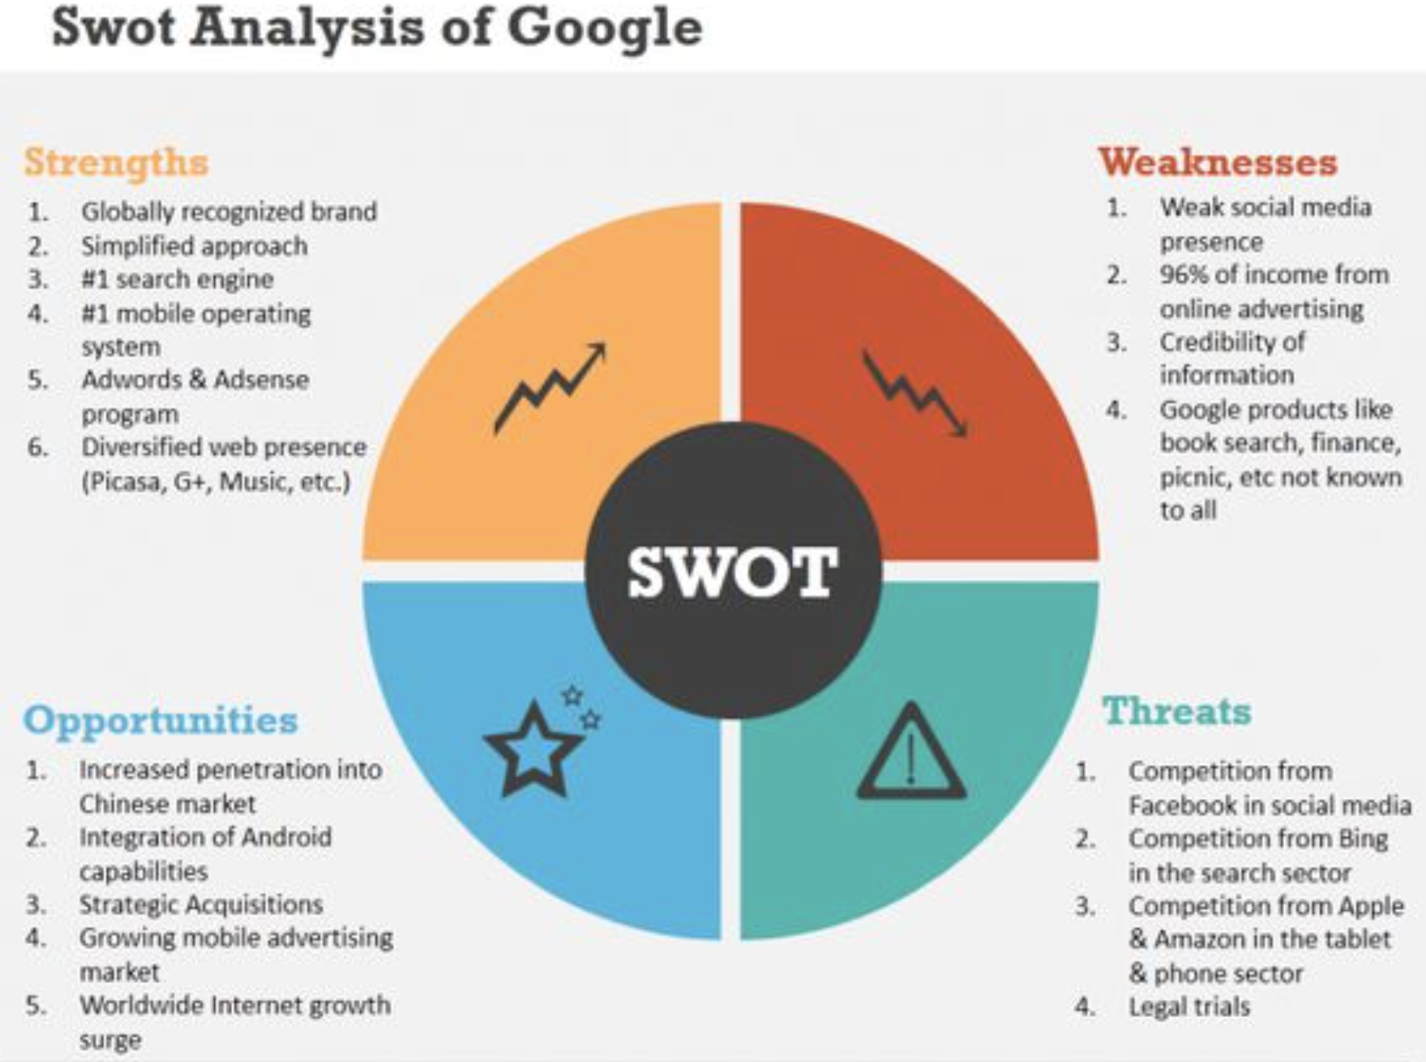
SWOT Analysis
SWOT Analysis: What are the Strengths, Weaknesses, Opportunities, and Threats that your company (especially your marketing team) is facing?

Slide 27
Goals & KPIs
What is success?

Slide 28
Goals - 30 Days
1,000 online visitors, 100 email subscribers, and 10 customers from marketing efforts to drive awareness.
Convert 5 subscribers to customers through email campaigns.
Rank in the top ten search results for “looking for marketing…,” “where to start with marketing,” “starting a career in marketing,” “marketing best practices,” and “transitioning to a marketing career.”
Publish 5 articles.

Slide 29
Goals - 60 Days
2,500 online visitors, 200 email subscribers, and 20 customers from marketing efforts to drive awareness.
Convert 10 subscribers to customers through email campaigns.
Rank in the top five search results for “looking for marketing…,” “where to start with marketing,” “starting a career in marketing,” “marketing best practices,” and “transitioning to a marketing career.”
Publish 10 articles.
1,000 social media followers.

Slide 30
Goals - 90 Days
5,000 online visitors, 400 email subscribers, and 30 customers from marketing efforts to drive awareness.
Convert 20 subscribers to customers through email campaigns.
Rank as the number one search result for “looking for marketing…,” “where to start with marketing,” “starting a career in marketing,” “marketing best practices,” and “transitioning to a marketing career.”
Publish 15 articles.
2,500 social media followers and 10% engagement.

Slide 31
KPIs (measured with)
Website visitors (Google Analytics)
Total email subscriber count (email marketing software)
Total number of customers (GA goals/payment dashboard)
Organic site ranking (SEMrush)
Number of articles published
Social media
  Engagement (likes, shares, comments)
  Reach (views)
  Leads (subscribers)
  Conversions (purchases)
ℹ️ KPI - A means to measure the performance of various factors, from employee functions to marketing tactics. Tracking KPIs will help your organization achieve its goals.

Slide 32
User Personas
Identifying our audience

Slide 33
Persona - Student
Who?
- Background (Job? Career path? Family?)
No job, still in school (high school/college) and studying at night, or regular job looking for something more. Undecided on career path or looking to change education path. No familial responsibilities.
- Demographics (Male or female? Age? Income? Location?)
Either gender, age 18-28, lower income/minimum wage, USA
- Identifiers (Demeanor? Communication preferences?)
Undecided/unsure, wanting a change, self-researcher, heavy mobile user
What?
- Goals (Primary goal? Secondary goal?)
Wants to know what it’s really like to work as a marketing professional, understand the different positions in the marketing industry, and how to get started in a specific marketing position.
- Challenges (Primary challenge? Secondary challenge?)
Young and unsure of self, afraid of school debt/costs, taking a leap of faith.
- What Can We Do (...to help our persona achieve their goals? ...to overcome their challenges?)
Provide resources to take some of the unknown out of the equation, as well as mastermind/counseling and one-on-one interviews.
Why?
- Real Quotes (About quotes, challenges, etc.)
“I’m interested and think I’ll be good in a marketing position, but I’m not sure where to begin.” “I would feel more comfortable talking with a professional in that position to get a better idea of the challenges and successes.”
- Common Objections (Why wouldn't they buy your product/service?)
Not sure if the information is legitimate or up-to-date. Unsure if this is a marketing scam or money grab.
How?
- Marketing Messaging (How should you describe your solution?)
A no-risk, no-commitment, community-backed online resource to introduce people to the marketing industry and all the opportunities within it.
- Elevator Pitch (Sell your persona on your solution)
Unsure of your career path? Consider a career in the marketing industry. Get insights from people all over the marketing landscape. From designers, communities managers, analytical thinkers, technology enthusiasts, and digital strategists.

Slide 34
Persona - Career Jumper
Who?
- Background (Job? Career path? Family?)
9-5er, in a job but looking for a career or a career change. Married with 1-2 kids.
- Demographics (Male or female? Age? Income? Location?)
Either gender, age 27-37, 40-75k annually, USA
- Identifiers (Demeanor? Communication preferences?)
Stressed and tired, feels like they’re not getting anywhere in current field/job, has come to realize their current career path isn’t for them. Self-researcher but not a lot of time between job and family. Mobile user first, desktop second.
What?
- Goals (Primary goal? Secondary goal?)
Make more money, do something that excites them again, looking to regain that fire/spark for what they do. Considered a marketing job but was never sure how to get started or if it’s right for them.
- Challenges (Primary challenge? Secondary challenge?)
Limited time, working late hours or managing family. Can’t take a huge pay cut, might be the primary home income.
- What Can We Do (...to help our persona achieve their goals? ...to overcome their challenges?)
Be a free resource that allows them to learn more and plan their career move. A resource to give them advice on the industry/career they’re interested in.
Why?
- Real Quotes (About quotes, challenges, etc.)
“I’m tired of working at this job without any sign of improvement.” “I need a career that I’m more excited about each day.” “I want to do better for my family.”
- Common Objections (Why wouldn't they buy your product/service?)
Not a lot of time to read long articles, not sure whether to trust information presented to help make a big career decision that affects family’s well-being.
How?
- Marketing Messaging (How should you describe your solution?)
Find career help through thoughtful and informative resources.
- Elevator Pitch (Sell your persona on your solution)
We provide free resources and access to professionals throughout the marketing industry with no commitment. We are simply a group people who love what they do and want to share it with others.

Slide 35
Persona - Marketing Professional
Who?
- Background (Job? Career path? Family?)
In the marketing industry, newer to the position or looking to grow/refine skills. Married/single with 1-3 kids.
- Demographics (Male or female? Age? Income? Location?)
Either gender, age 24-54, 40-120k annually, USA
- Identifiers (Demeanor? Communication preferences?)
Busy marketing professional, wants information delivered, has little time to research or read long form articles without a clear summary or non-clickbait topic.
What?
- Goals (Primary goal? Secondary goal?)
Learn new or stay on top of best practices in the industry. Looking to expand their knowledge in general or specific marketing topics.
- Challenges (Primary challenge? Secondary challenge?)
Busy professional, doesn’t have time for spam or unrelated topics to their primary function or industry.
- What Can We Do (...to help our persona achieve their goals? ...to overcome their challenges?)
Customize topics and communication based on the things they care about.
Why?
- Real Quotes (About quotes, challenges, etc.)
“I have a busy day, the last thing I need is another marketing clickbait email to get me to sign up or give information to something.” “I want the most important topics related to what I care about at the top of the newsfeed.” “I’m looking for new ideas, case studies, and industry news from well-written sources.”
- Common Objections (Why wouldn't they buy your product/service?)
Too many “marketing” sites making the same claims, wants to know how the information is better and what’s different with yours.
How?
- Marketing Messaging (How should you describe your solution?)
A simple, to-the-point online resource providing help and ideas from others in the industry.
- Elevator Pitch (Sell your persona on your solution)
We offer real information — no fluff – from others in similar positions without commitment or spam.

Slide 36
Content Plan
Article topics and site content

Slide 37
Types of Content - Content Pillars
Student
- Interviewer style Q&A
- How to get started
- One-on-one counseling video/calls
Career Jumper
- Testimonials
- How to get started
- TL;DR articles
- Latest news and trends
Marketing Professional
- TL;DR articles
- Statistics and case studies
- Best practices
- Latest news and trends

Slide 38
Content Topics
Student
- Certifications (free/paid)
- Interviews and articles from people in the field
- Testimonials from people new to the industry
- Information on different marketing fields
- How to get started in those fields
- Things to know for an interview
Career Jumper
- Testimonials of how others made the transition
- Statistics and case studies on marketing job growth and skills needed
- Things to know for an interview
Marketing Professional
- Specific industry news
- Statistics and case studies
- Content-specific fields and/or industry
- Best practices

Slide 39
Design & Style Guide
Our look and feel

Slide 40
Brand Story
OUR VISION
Be the resource for people interested in the marketing field and for anyone looking to grow an online brand, product, or service through clean and thoughtful guides.
OUR MISSION
We help people succeed in the marketing industry.

Slide 41














Moodboard

Slide 42
Voice
WORDS WE LIKE
Helpful
Inspiring
Direct
Share
Community
WORDS WE DON’T LIKE
Spam
Intrusive
“Click to read more”
“Top 10 list”

Slide 43
Logo

Slide 44
Logo Guidelines
Don’t squish or stretch the logo or use with bright colors

Slide 45
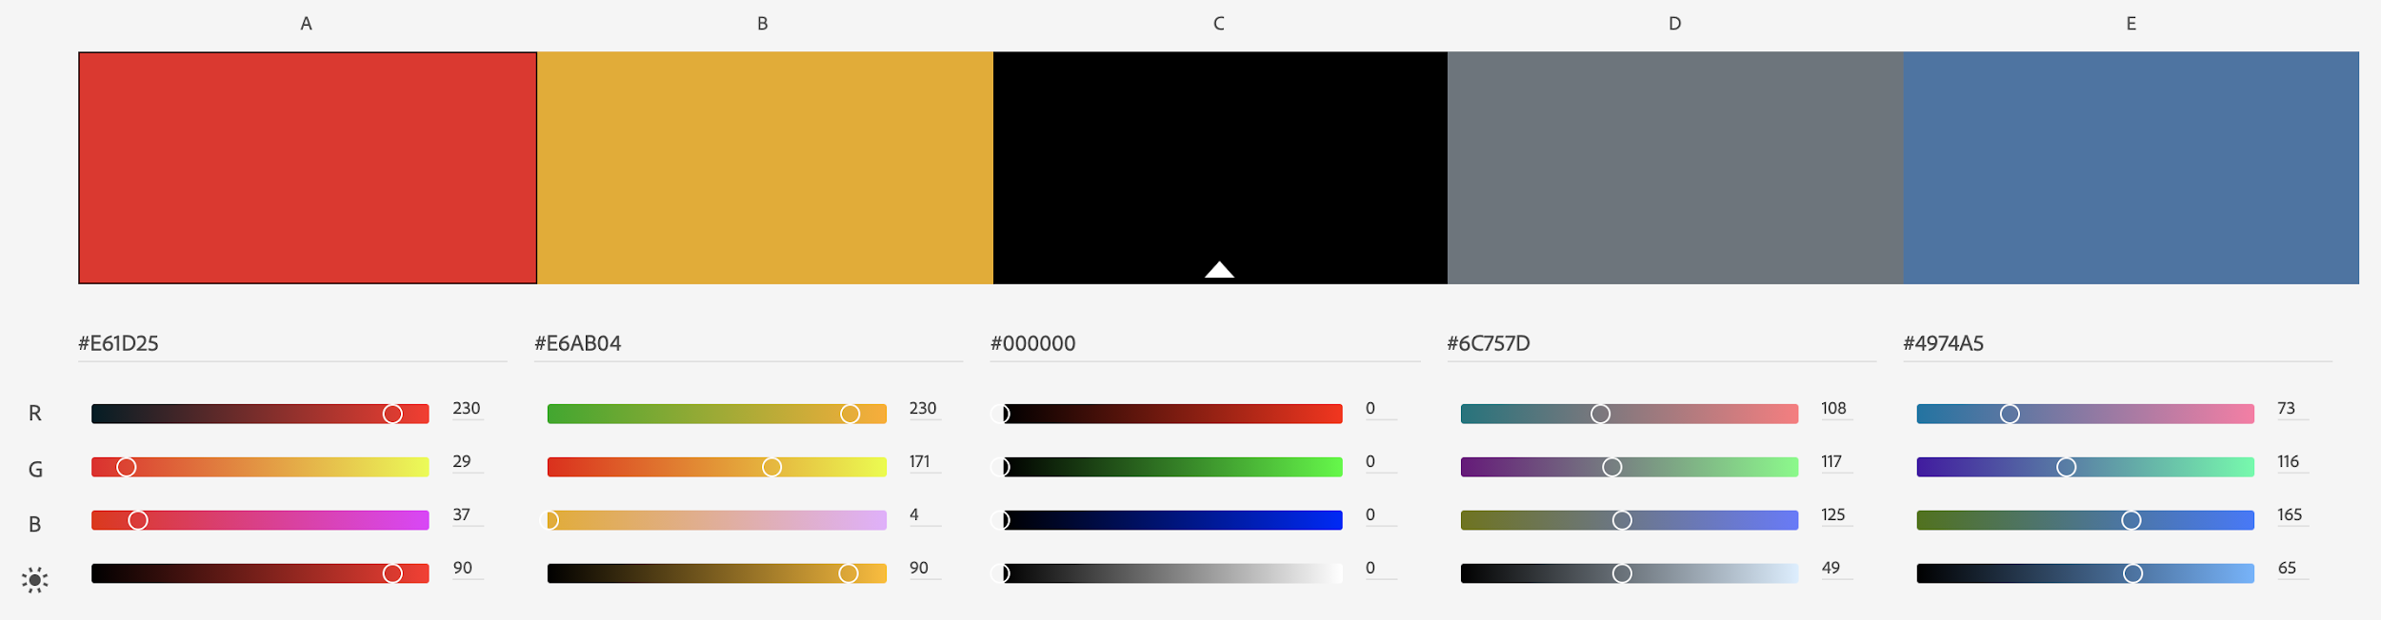
Brand Colors
https://color.adobe.com/Looking-For-Marketing-color-theme-15806087

Slide 46
Typography
Roboto
abcdefghijklmnopqrstuvwxyz
ABCDEFGHIJKLMNOPQRSTUVWXYZ
Roboto Bold
abcdefghijklmnopqrstuvwxyz
ABCDEFGHIJKLMNOPQRSTUVWXYZ

Slide 47
Website & UX
Hello World

Slide 48
Website - Functionality
Resource Directory
Tools
Courses
Books
Events
Terminology
News Feeds
Job Board and Professional Directories
Users can post that they are looking for a job
Employers can post job openings
User auth/profiles
Customized subscription/content types
Profile landing page, job title, areas they specialize in
Author hub, where validated accounts can add content
Comment & Rating System

Slide 49
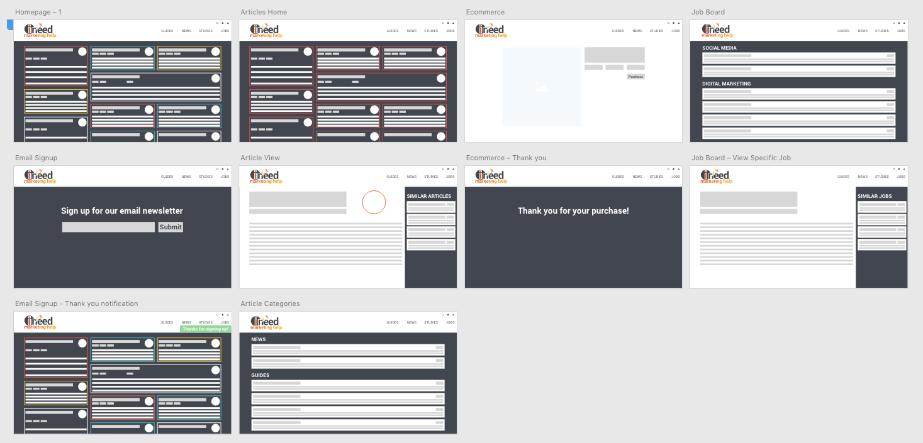
Website - Desktop UX

Slide 50
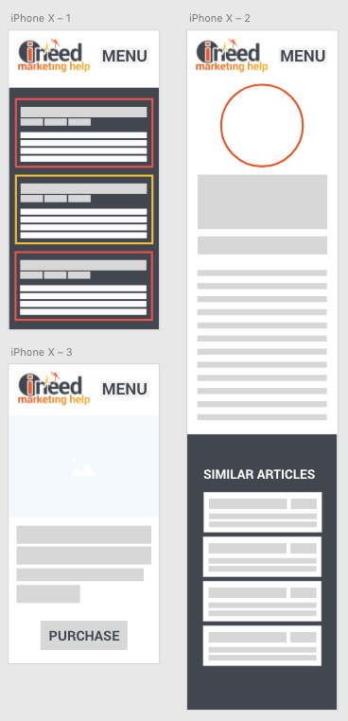
Website - Mobile UX

Slide 51
Social Media
Please Like, Follow, and Subscribe

Slide 52
Networks & Posting Cadence
Facebook:
One or two posts daily
Instagram:
Two posts daily
LinkedIn:
One post daily
Twitter:
Twelve posts daily
YouTube:
One post daily
Pinterest:
Ten posts daily
* These aren’t end-all, be-all numbers; testing and research for your audience is needed

Slide 53
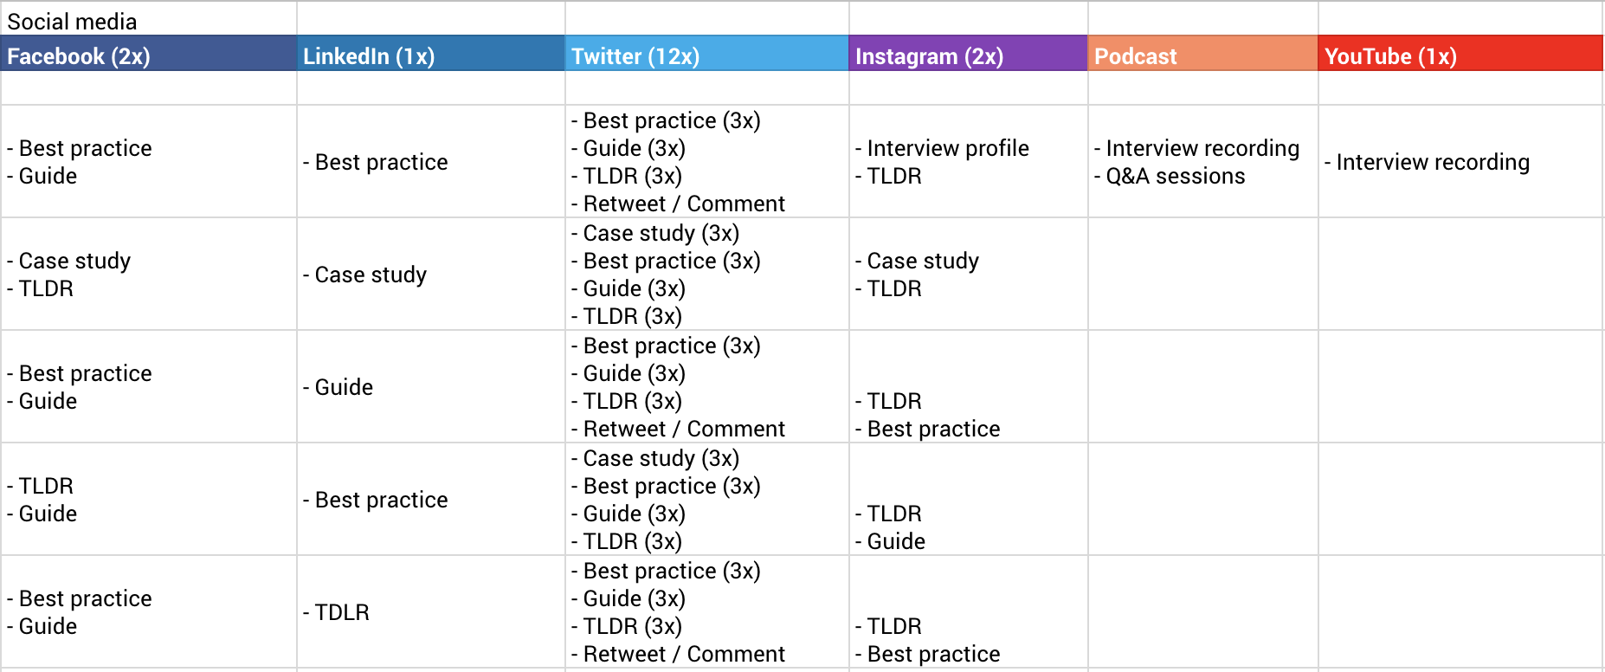
Posting Schedule

