Slide 1


(Unique) Value Proposition Workshop for Consultancies
Workshop

Slide 2

Contents
Workshop Guidance
Prior to Workshop
6 Step Workshop

Slide 3
This presentation shows you how to develop your UVP through a workshop.
This should be an enjoyable, inclusive effort. Make it an occasion to build your team!
Don’t focus on what you offer now, but what you could be in 1-2 years!
Workshop Guidance

Slide 4

The Client…..
The client is the wrong unit of analysis
What job are they trying to get done?
The Jobs To Be Done (JTBD) approach

Slide 5


Why buy a milkshake?
“Because it tastes good”
Half the milkshakes were sold before 8am.
People were alone when they bought it
It was the only thing they bought
They drove right off with it
“Because it keeps me full until noon. I need to drink it in the vehicle while I drive to work”

Slide 6








The Value Proposition Canvas
Workshop Guidance
  Gain Creators
  Gain
  Products & Services
  Customer Jobs(s)
  Pain Relivers
  Pains
Notes:
JTBD can be social, functional or emotional

Slide 7

Aim to create unique, compelling and targeted propositions that command market attention.
If you're in the 'me too' zone you’re doing something wrong.

Slide 8

Workshop Preparation

Slide 9

PRE-READING
  Strategy
  Niche / Avatar Statement
  Values & Culture Statements
  Competitor Analysis
  Market Analysis
Workshop Preparation

Slide 10





Use a room with post-its. Get people on their feet. Temper headstrong personalities.
Use and mix up break-outs. Activities should be done in small groups and bought together.
Do not vote on anything. Avoid groupthink or decision by committee.
Workshop facilitation by a senior client or an independent experienced facilitator (ahem!).
Consider not inviting the partners until the end. Perhaps using pitches to sell different UVPs to the leadership.
This should be done by those that deliver AND sell the work .

Slide 11

Six Step Workshop

Slide 12
1. TOP DOWN
In pairs review each document to find five phrases why your ideal client would buy from your firm.
Think about the way you work, your values, your way of working, the type of people you employ, what you are most passionate about and what you’re great at.

Slide 13

2. BOTTOM-UP
In pairs review each service-line to identify the client value it brings.
Think of the problems it solves or the opportunities it fulfils.
Use the language of your clients and their pain-points / concerns

Slide 14

3. VALUE SCORING
  Score each phrase out of 3 in terms of how important these are your clients
  Remove anything that scores less than 2

Slide 15

4. UNIQUE SCORING
  Review your competitor analysis
  Score each phrase out of 3 as to whether your competitors do these well.
  Remove anything that scores less than 2

Slide 16
Workshop
5. CRAFTING
Bring together both sets of surviving post-its
Translate your phrases into the language of your clients
Each pair to create 3 sentences that best encapsulate your unique value
- One describing what you achieve for your clients they value most
- One describing how you achieve this
- One providing more detail on the client benefits
Avoid vanilla at any cost, if you appeal to everyone, you appeal to no-one.

Slide 17

6. REVIEW & IMPROVE
  Whittle down to one UVP
  Review within the organisation, with stakeholders and with clients
  Plan the launch!

Slide 18

Review your UVP every year, every time you launch a new service or market, and every time you are facing radical market changes

Slide 19
www.joeomahoney.com

Slide 20

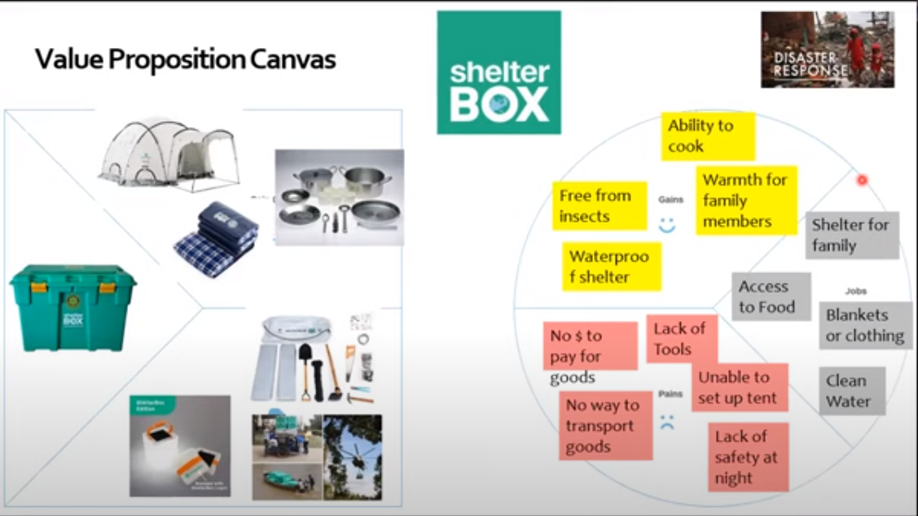
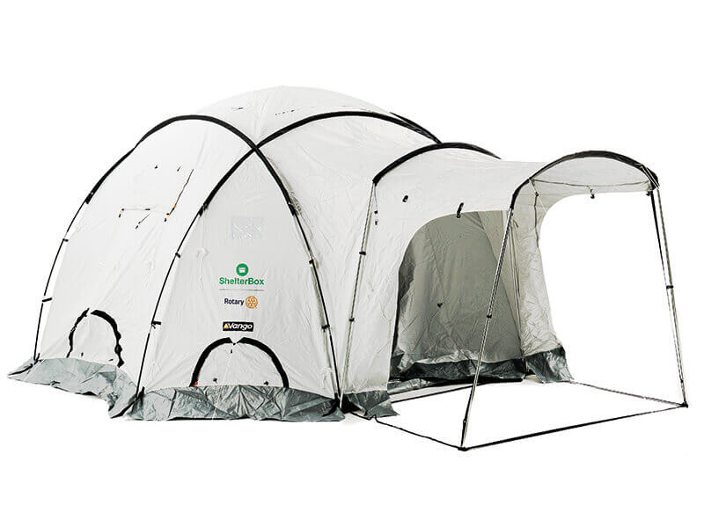
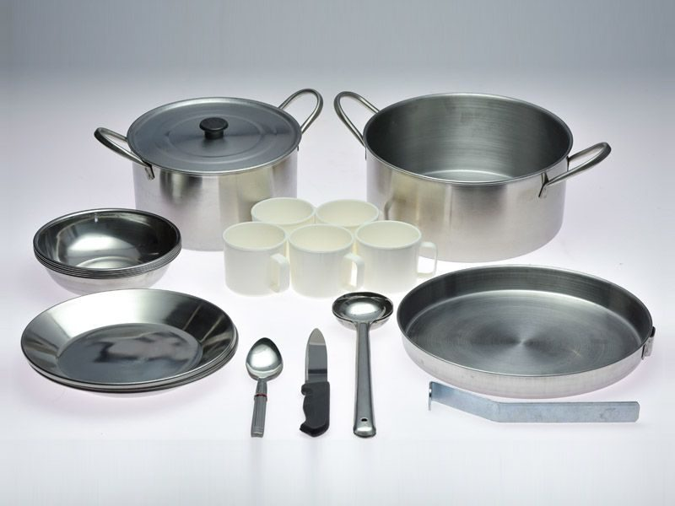


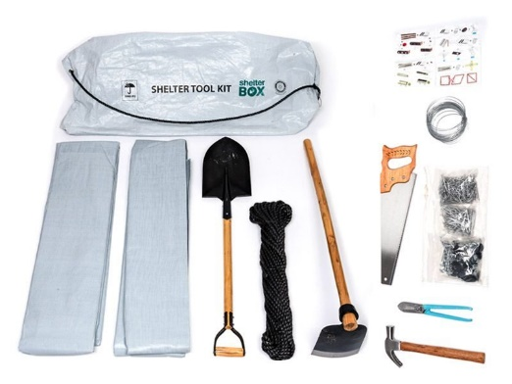
Value Proposition Canvas
Waterproof shelter
Free from
insects
Ability to
cook
Access to food
Warmth for family
members
Gains
Shelter for family
Jobs to be done
No way to transport goods
Lack
of
tools
Blankets or clothing
Lack of safety at night
Pains
Clean water
Unable to set up tent

Slide 21



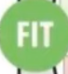
Value Proposition Canvas
TESLA
UPPER MIDDLE CLASS MALE
$100K+ INCOME
Performance like a sports car
Autonomous car
Gain creators
Gains
High end battery tech
Performance 0-100 KM/H
4.45-6.25
Brand recognition
8 Years battery warranty
Focus on design & style
Be different from others
Compliments from friends
Range of 250-400 KM
High-tech feel
17” touch screen
Seating 4-7
Occasional long-distance trips
Few options
High safety ratings
design
Products & services
Jobs to be done
Pain relievers
Lack of charging stations
Commute to work
Accident and harm
Personal mobility
Model X
Model 3
Model S
60-85 KWh
Charging network
Frequent charging
Convey an image to success
Fear of dead battery
Buy before price drop
Charging
45-90 KM/H
5+2 seats
Pains

Slide 22


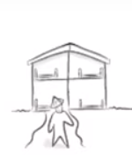
Extra
revenue
Profitable rental
Worldwide
reach
Global marketing
Gains
Match making
Gain creators
Review &
stars
Visibility of Quality
Online
booking
Match supply & demand
Airbnb
community
Repeat business
Secure paying client
Products & services
Customer Jobs
Pain relievers
Pains
Trust ?
Market quality experience
Payment mechanism
Damage insurance
Risk of damage
Get repeat business
Resolution support
Verified ID
Legal protection
Secure
payment
Difficulty to be paid

Slide 23
Extra
revenue
Profitable rental
Easy profits
Worldwide
reach
Global marketing
Global audience
Review &
stars
Visibility of Quality
Easy profits
We help you make money by safely marketing your rooms to a global audience.
Airbnb
community
Repeat business
Easy profits
Damage insurance
Risk of damage
Security
Verified ID
Legal protection
Security
Secure
payment
Difficulty to be paid
Security

Slide 24
Ad-Lib Value Proposition Template
Force you to pinpoint how exactly you are going to create value
Create several alternative pitches
Our help{s) who want to
(Products and Services)
(Customer Segment)
(jobs to be done)
By and
(verb (e.g.., r educing, avoiding) and a customer pain) (verb (e.g.., increasing, enabling) and a customer gain)
(unlike ( )
(competing value proposition)

